Slide 1

8th Grade Math: Pre-Algebra
Unit 3, Lesson 1 Powers of 10 Volume 1, pg. 81

Slide 2


Benchmark
MA.8.NSO.1.3
Extend previous understanding of the Laws of Exponents to include integer exponents. Apply the Laws of Exponents to evaluate numerical expressions and generate equivalent numerical expressions, limited to integer exponents and rational number bases, with procedural fluency.
volume 1, pg. 81

Slide 3
Integrated Mathematical Thinking and Reasoning Standards
MA.K12.MTR.3.1 Complete tasks with mathematical fluency.
MA.K12.MTR.4.1 Engage in discussions that reflect on the mathematical thinking of self and others.
MA.K12.MTR.5.1 Use patterns and structure to help understand and connect mathematical concepts.
volume 1, pg. 81

Slide 4


Learning Target
I can use the Laws of Exponents to evaluate numerical expressions with a base of $10$ and exponents greater than or equal to $0$.
volume 1, pg. 81

Slide 5

Warm-Up
volume 1, pg. 81

Slide 6
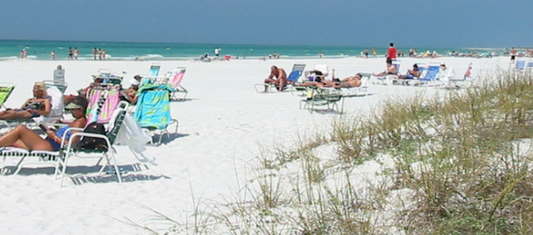
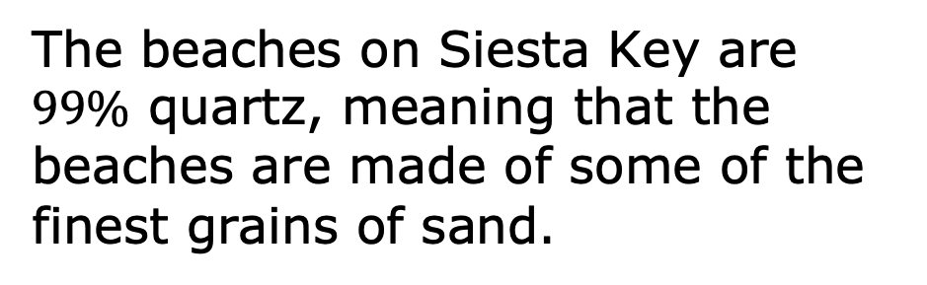
3.1.1 Warm-Up: Grains of Sand
The beaches on Siesta Key are $99\%$ quartz, meaning that the beaches are made of some of the finest grains of sand.
Suppose you have a teaspoon of the sand from Siesta Key. How could the teaspoon of sand be used to estimate the number of grains of sand in a bucket of sand?
volume 1, pg. 81
Notes:
Video Link: https://algebranation.wistia.com/medias/fi4fidi5y8

Slide 7
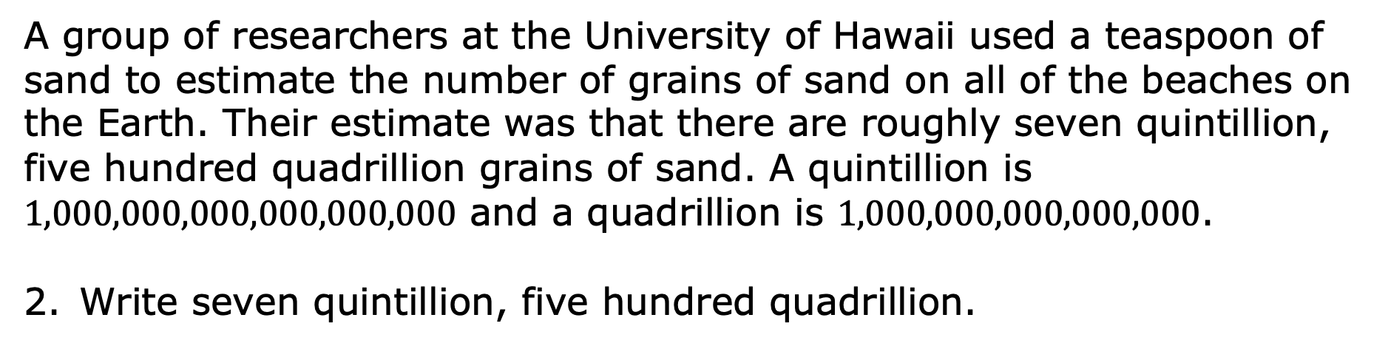
A group of researchers at the University of Hawaii used a teaspoon of sand to estimate the number of grains of sand on all of the beaches on the Earth. Their estimate was that there are roughly seven quintillion, five hundred quadrillion grains of sand. A quintillion is $1,000,000,000,000,000,000$ and a quadrillion is $1,000,000,000,000,000$.
Write seven quintillion, five hundred quadrillion.
volume 1, pg. 81
Notes:
Video Link: https://algebranation.wistia.com/medias/fi4fidi5y8

Slide 8

Exploration
volume 1, pg. 82

Slide 9
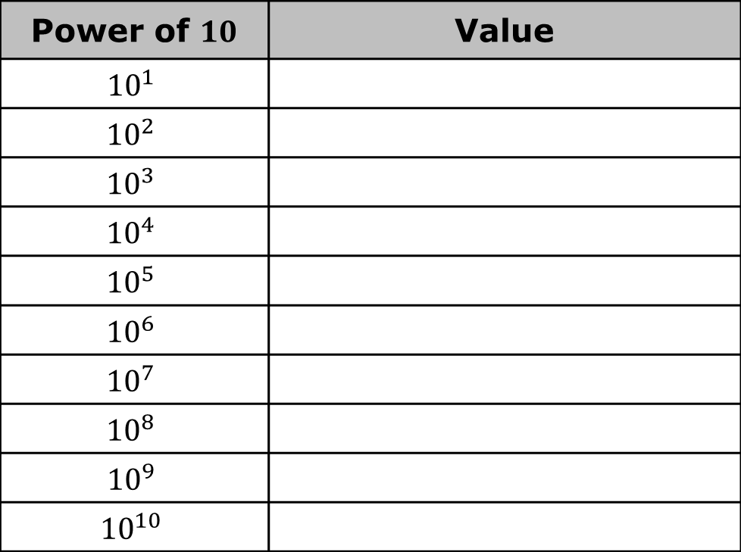
3.1.2 Exploration: Powers of Ten
Use a scientific calculator to find the value of each power of $10$.
Power of $10$ | Value
$${10}^{1}$$
$${10}^{2}$$
$${10}^{3}$$
$${10}^{4}$$
$${10}^{5}$$
$${10}^{6}$$
$${10}^{7}$$
$${10}^{8}$$
$${10}^{9}$$
$${10}^{10}$$
volume 1, pg. 82

Slide 10
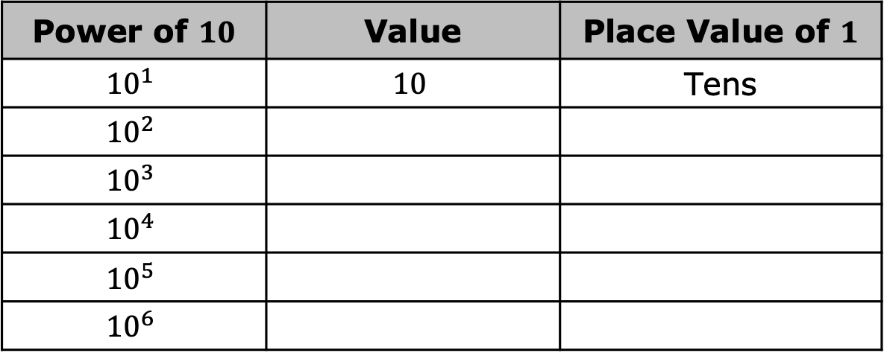
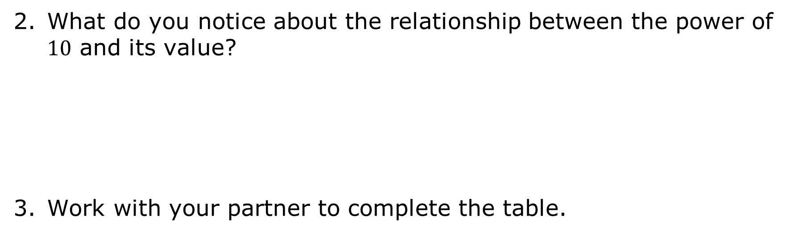
What do you notice about the relationship between the power of $10$ and its value?
Work with your partner to complete the table.
Power of $10$ | Value | Place Value of $1$
$${10}^{1}$$ | $$10$$ | Tens
$${10}^{2}$$
$${10}^{3}$$
$${10}^{4}$$
$${10}^{5}$$
$${10}^{6}$$
volume 1, pg. 82

Slide 11
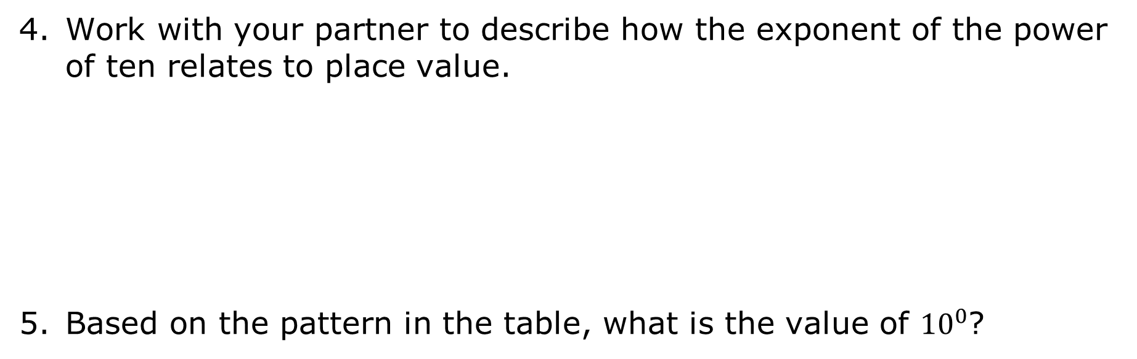
Work with your partner to describe how the exponent of the power of ten relates to place value.
Based on the pattern in the table, what is the value of ${10}^{0}$?
volume 1, pg. 82

Slide 12

Try It
volume 1, pg. 83

Slide 13
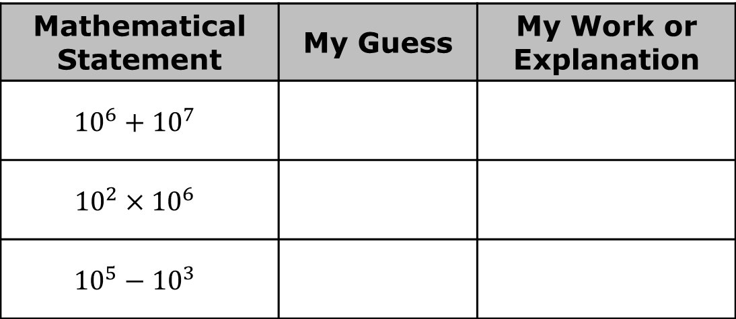
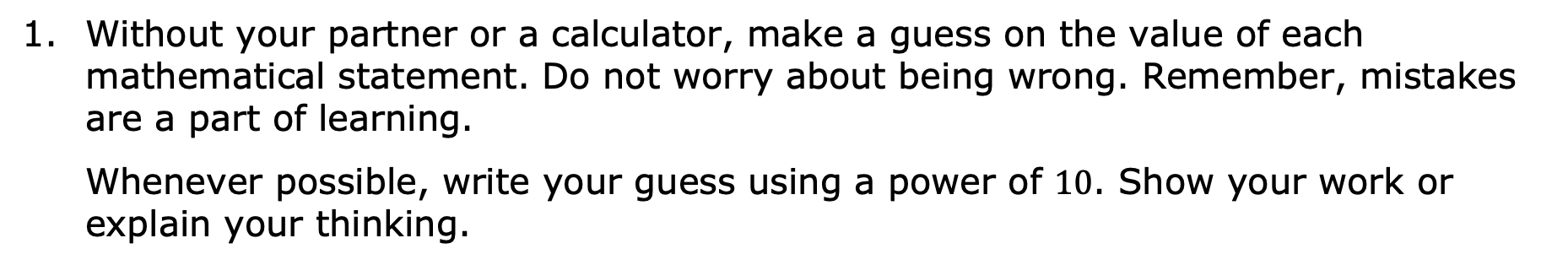
3.1.3 Try It: Make a Guess
Without your partner or a calculator, make a guess on the value of each mathematical statement. Do not worry about being wrong. Remember, mistakes are a part of learning.
Whenever possible, write your guess using a power of $10$. Show your work or explain your thinking.
Mathematical Statement | My Guess | My Work or Explanation
$${10}^{6}+{10}^{7}$$
$${10}^{2}×{10}^{6}$$
$${10}^{5}−{10}^{3}$$
volume 1, pg. 83

Slide 14

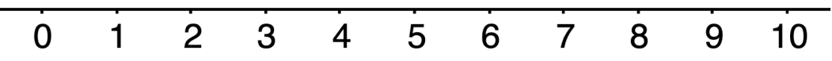

Mathematical Statement | My Guess | My Work or Explanation
$$\frac{{10}^{6}}{{10}^{4}}$$
$${\left({10}^{4}\right)}^{2}$$
$$\frac{1}{{10}^{2}}$$
How confident are you in your guesses? Use the emoji scale to rate your confidence in your guesses.
volume 1, pg. 83

Slide 15
Exploration
volume 1, pg. 83

Slide 16
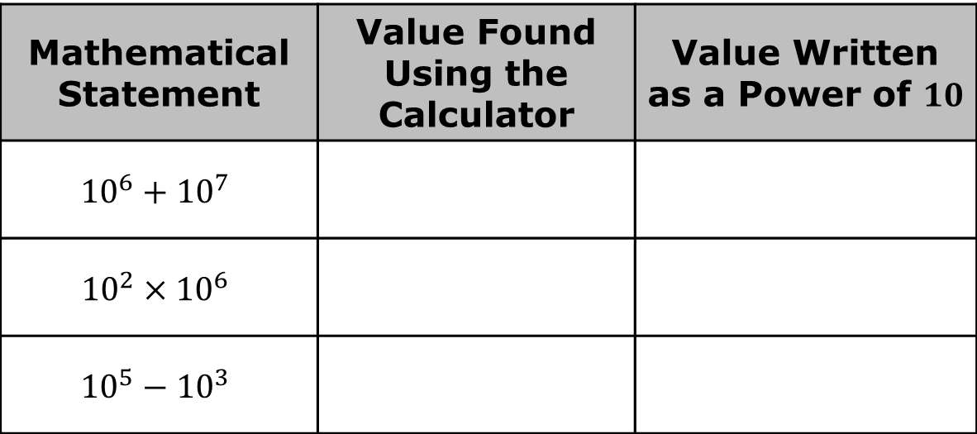
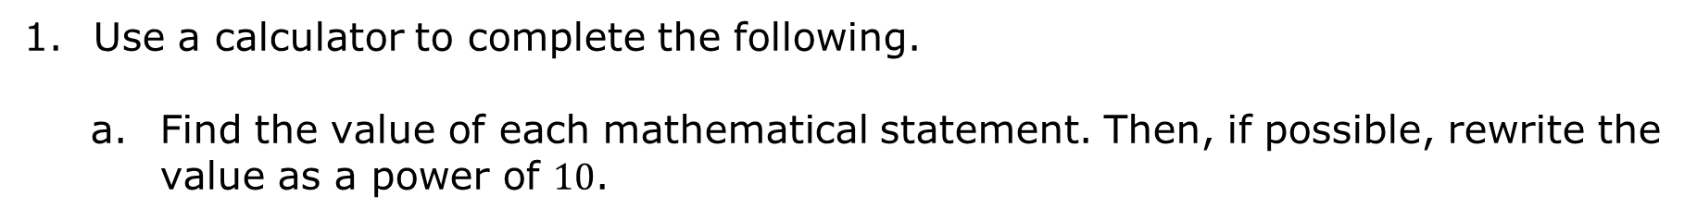
3.1.4 Exploration: Using a Calculator to Check
Use a calculator to complete the following.
Find the value of each mathematical statement. Then, if possible, rewrite the value as a power of $10$.
Mathematical Statement | Value Found Using the Calculator | Value Written as a Power of $10$
$${10}^{6}+{10}^{7}$$
$${10}^{2}×{10}^{6}$$
$${10}^{5}−{10}^{3}$$
volume 1, pg. 83

Slide 17
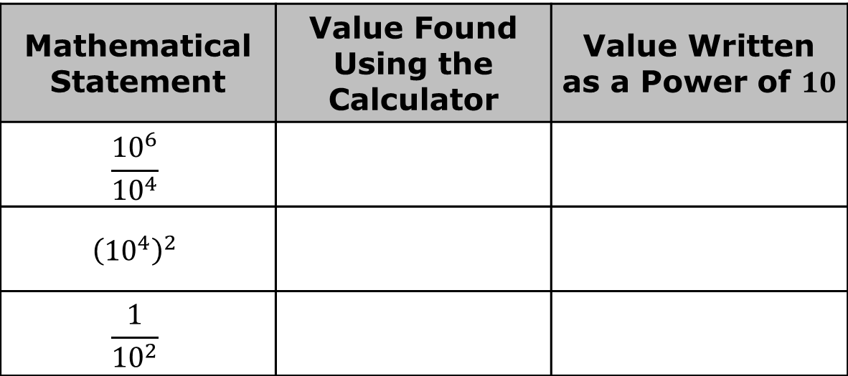
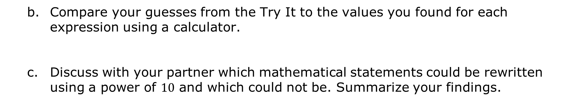
Mathematical Statement | Value Found Using the Calculator | Value Written as a Power of $10$
$$\frac{{10}^{6}}{{10}^{4}}$$
$${\left({10}^{4}\right)}^{2}$$
$$\frac{1}{{10}^{2}}$$
Compare your guesses from the Try It to the values you found for each expression using a calculator.
Discuss with your partner which mathematical statements could be rewritten using a power of $10$ and which could not be. Summarize your findings.
volume 1, pg. 83

Slide 18

Refresher
volume 1, pg. 84

Slide 19



3.1.5 Refresher: Laws of Exponents
The Laws of Exponents may help explain why some of the mathematical statements could be rewritten using a power of $10$.
Which is an example of the product of powers exponent law?
${\left(a^{m}\right)}^{n}=a^{mn}$
${\left(a^{m}\right)}^{n}=a^{m+n}$
$a^{m}·a^{n}=a^{mn}$
$a^{m}·a^{n}=a^{m+n}$
Product of Powers Exponent Law
When multiplying two powers that have the same nonzero base, keep the base and add the exponents.
volume 1, pg. 84

Slide 20

Which is an example of the power of a power exponent law?
${\left(a^{m}\right)}^{n}=a^{mn}$
${\left(a^{m}\right)}^{n}=a^{m+n}$
$a^{m}·a^{n}=a^{mn}$
$a^{m}·a^{n}=a^{m+n}$
Power of a Power Exponent Law
When raising a power to a power, keep the base and multiply the exponents.
volume 1, pg. 84

Slide 21

Quotient of Powers Exponent Law
When dividing two powers that have the same nonzero base, keep the base and subtract the exponents.
Which is an example of the quotient of powers exponent law?
$\frac{a^{m}}{a^{n}}=a^{m−n}$
$\frac{a^{m}}{a^{n}}={\left(a−a\right)}^{m−n}$
$\frac{a^{m}}{a^{n}}=1^{m−n}$
volume 1, pg. 84

Slide 22
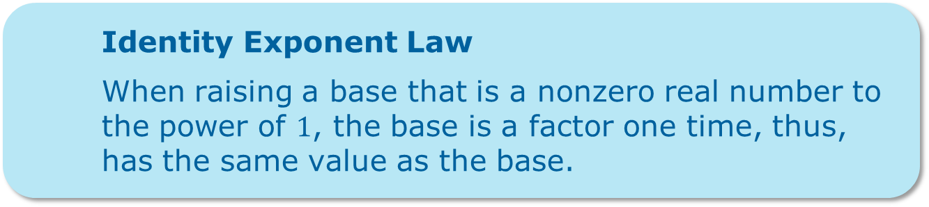
Write an example of the identity exponent law.
Identity Exponent Law
When raising a base that is a nonzero real number to the power of $1$, the base is a factor one time, thus, has the same value as the base.
volume 1, pg. 84

Slide 23
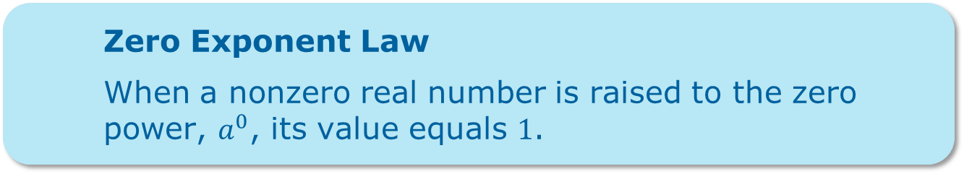
Write an example of the zero exponent law.
Zero Exponent Law
When a nonzero real number is raised to the zero power, $a^{0}$, its value equals $1$.
volume 1, pg. 84

Slide 24

Guided Practice
volume 1, pg. 85

Slide 25

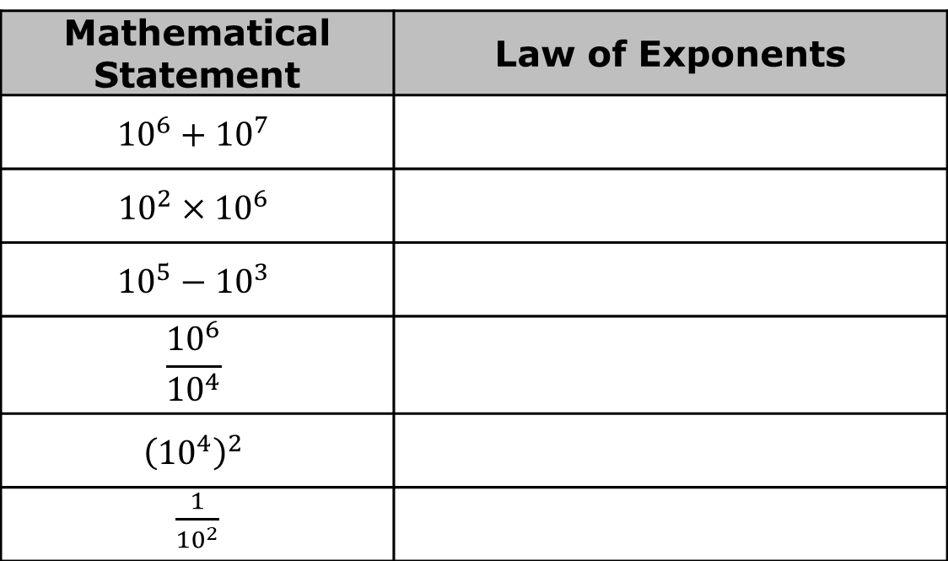
3.1.6 Guided Practice: Aligning Powers of 10 Statements with the Laws of Exponents
Determine which of the mathematical statements align with a law of exponents. Write the law in the table. If no law applies, then write “none.”
Mathematical Statement | Law of Exponents
$${10}^{6}+{10}^{7}$$
$${10}^{2}×{10}^{6}$$
$${10}^{5}−{10}^{3}$$
$$\frac{{10}^{6}}{{10}^{4}}$$
$${\left({10}^{4}\right)}^{2}$$
$\frac{1}{{10}^{2}}$
volume 1, pg. 85

Slide 26
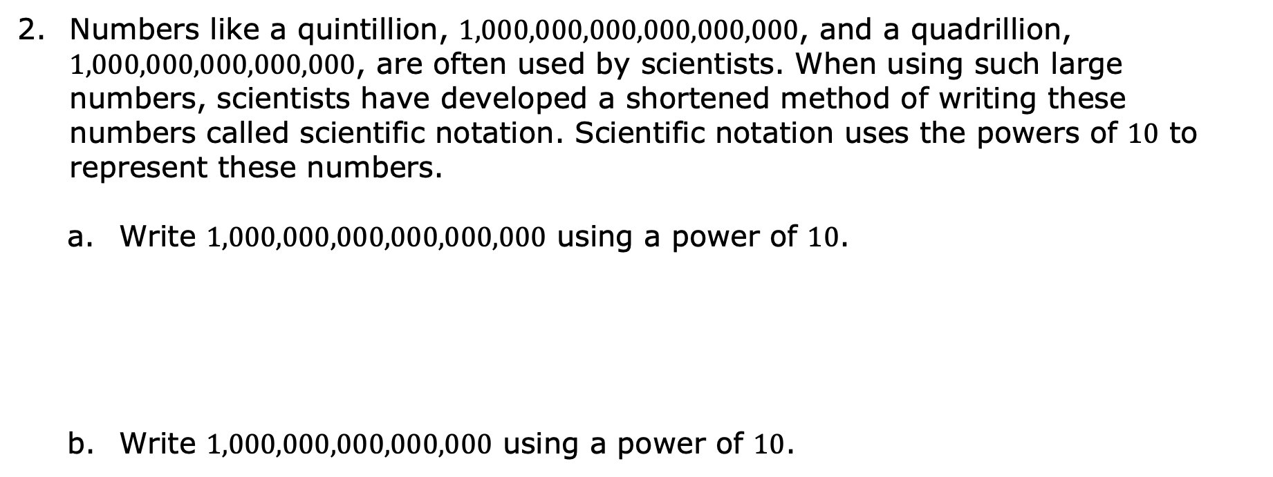
Numbers like a quintillion, $1,000,000,000,000,000,000$, and a quadrillion, $1,000,000,000,000,000$, are often used by scientists. When using such large numbers, scientists have developed a shortened method of writing these numbers called scientific notation. Scientific notation uses the powers of $10$ to represent these numbers.
Write $1,000,000,000,000,000,000$ using a power of $10$.
Write $1,000,000,000,000,000$ using a power of $10$.
volume 1, pg. 85

Slide 27

Wrap-Up
volume 1, pg. 85

Slide 28



3.1.7 Wrap-Up: Reflection
Choose the question and sign that best describes your understanding of today’s lesson.
Briefly explain why you feel this way.
Are you confused? | Are you in the school zone? | Are you ready for the highway?
volume 1, pg. 85

